Slide 1

COVID-19 Detection from Chest X-rays with CNN-Based Approach
Dwight Ross
Oct. 14, 2023
Tougaloo College

Slide 2
Background
COVID-19, a respiratory illness caused by the SARS-CoV-2 virus. Symptoms range from mild flu-like manifestations to severe pneumonia.
Early and Accurate Detection enables timely treatment, reducing the risk of severe complications.
Chest X-rays: Gold standard to check for lung infections.
Limitation: Requires skilled radiologists for interpretation; high demand can lead to increased wait times.

Slide 3
Aim of the Project
To develop a CNN-Based Approach using PyTorch that can efficiently classify chest X-ray images into one of two categories:
Pneumonia-related diseases (including COVID-19)
Normal (No sign of any infection)

Slide 4
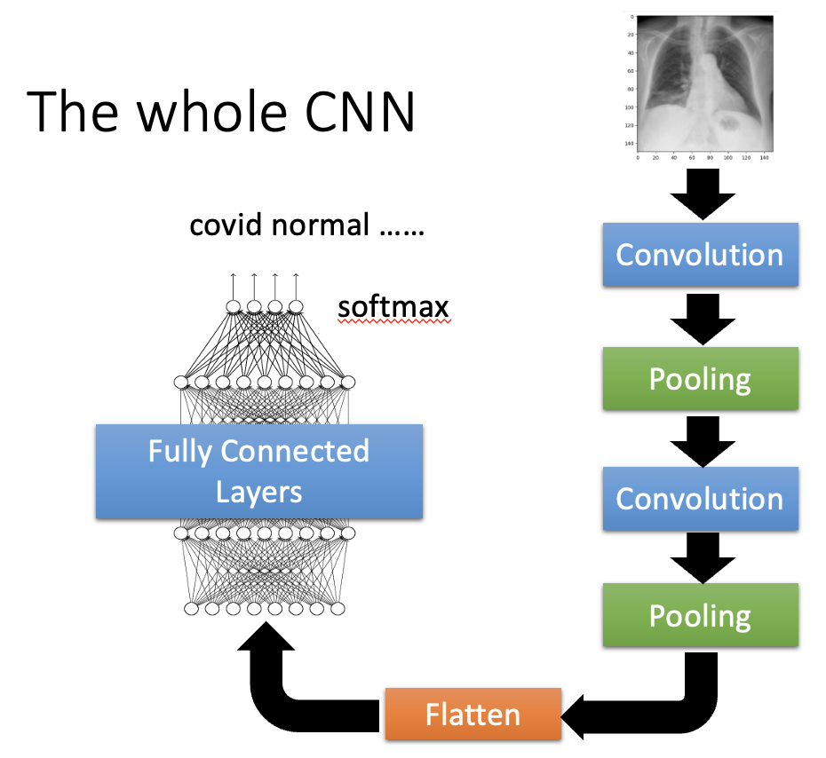
Convolutional Neural Networks (CNN)
Definition: A type of deep learning algorithm specifically designed to process structured grid data, such as an image.
Inspiration: Modeled after the human visual system.
Key Components:
Convolutional Layers: Apply convolutional operations to extract features from input data.
Pooling Layers: Reduce the spatial dimensions while retaining significant information.
Fully Connected Layers: Process and classify the extracted features into final output.

Slide 5
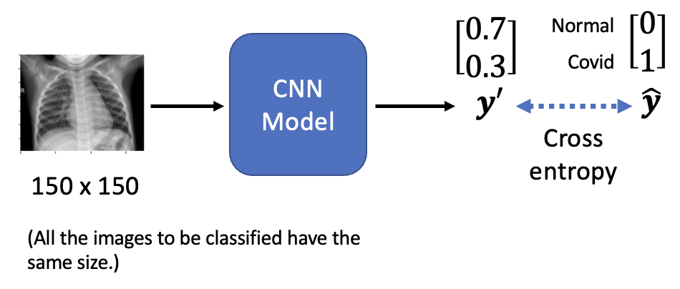
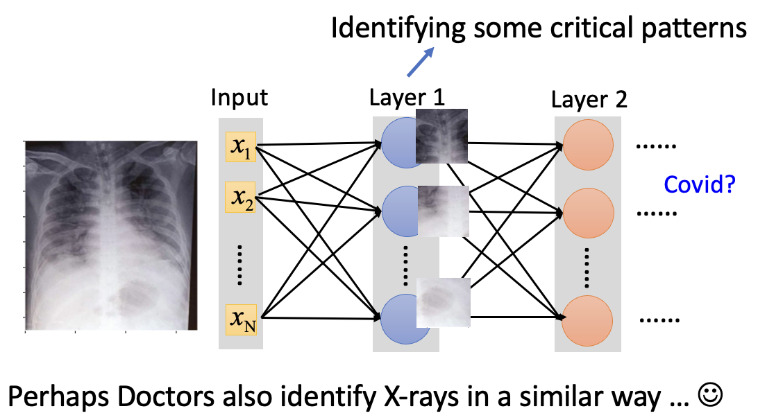
Training a CNN
Data Feeding: Input images are passed through the CNN layers.
Feature Extraction: Convolutional and pooling layers automatically extract relevant features from the images.
Convolutional Layers: Apply convolutional operations to extract features from input data.
Pooling Layers: Reduce the spatial dimensions while retaining significant information.
Fully Connected Layers: Process and classify the extracted features into final output.

Slide 6
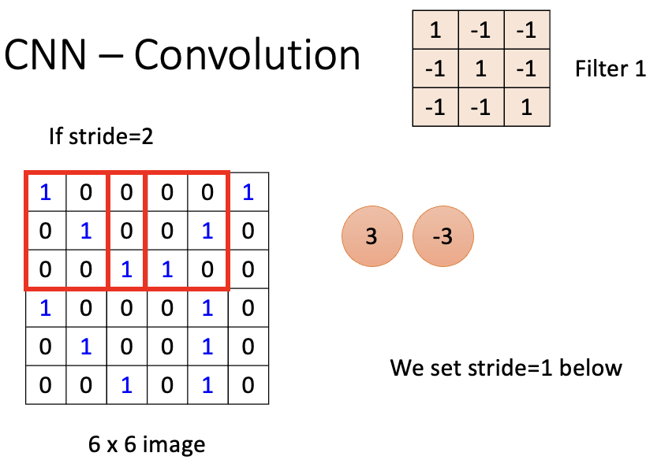

Training a CNN
Data Feeding: Input images are passed through the CNN layers.
Feature Extraction: Convolutional and pooling layers automatically extract relevant features from the images.
Convolutional Layers: Apply convolutional operations to extract features from input data.
Pooling Layers: Reduce the spatial dimensions while retaining significant information.
Fully Connected Layers: Process and classify the extracted features into final output.

Slide 7
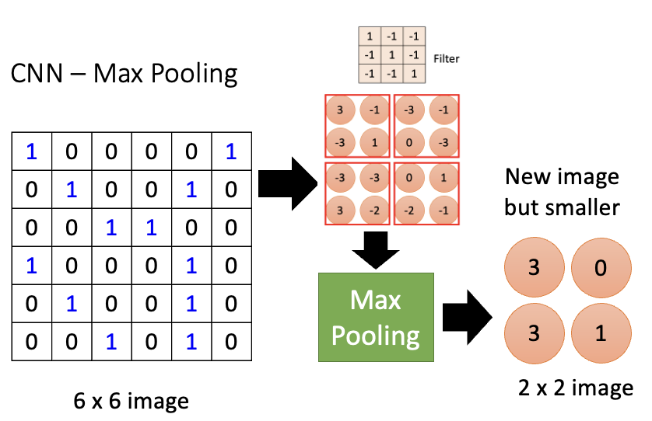

Training a CNN
Data Feeding: Input images are passed through the CNN layers.
Feature Extraction: Convolutional and pooling layers automatically extract relevant features from the images.
Convolutional Layers: Apply convolutional operations to extract features from input data.
Pooling Layers: Reduce the spatial dimensions while retaining significant information.
Fully Connected Layers: Process and classify the extracted features into final output.
Fully Connected Feedforward network

Slide 8
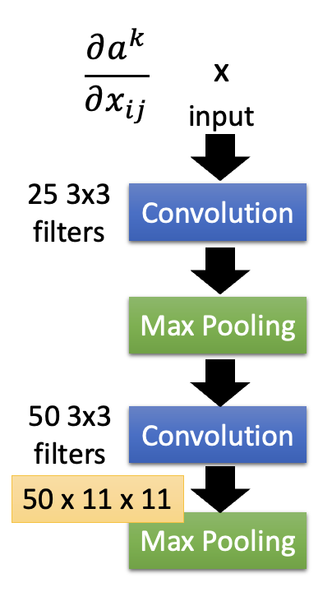
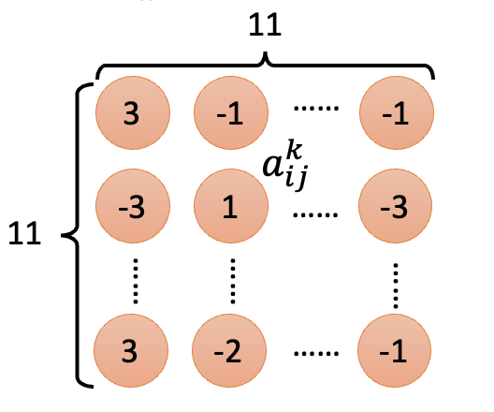
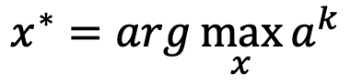
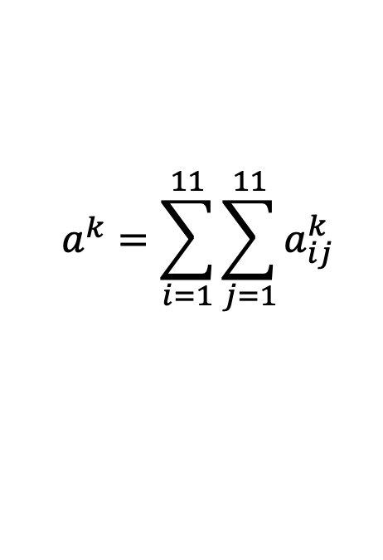
What does CNN learn?
The output of the k-th filter is a 11 x 11 matrix.
Degree of the activation of the k-th filter:
$$a^{k}=\sum_{i=1}^{11}{\sum_{j=1}^{11}{a_{ij}^{k}}}$$
$$x^{∗}=arg\max_{x}{a^{k}}$$
(gradient ascent)

Slide 9
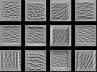
What does CNN learn?
The output of the k-th filter is a 11 x 11 matrix.
Degree of the activation of the k-th filter:
$$a^{k}=\sum_{i=1}^{11}{\sum_{j=1}^{11}{a_{ij}^{k}}}$$
$$x^{∗}=arg\max_{x}{a^{k}}$$
(gradient ascent)
For each filter

Slide 10
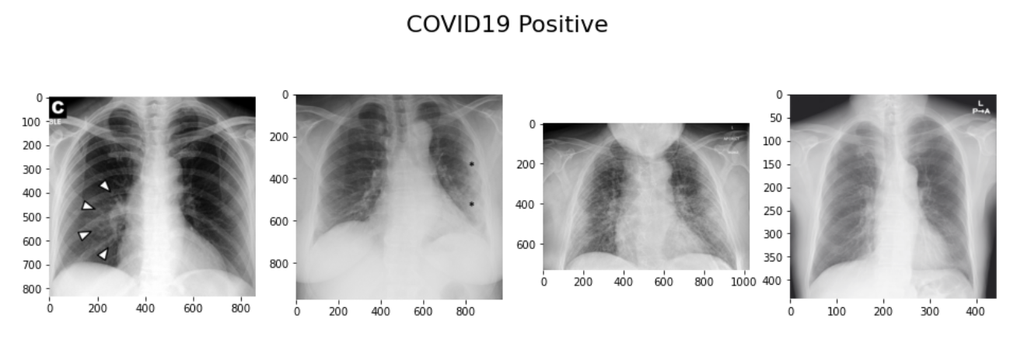
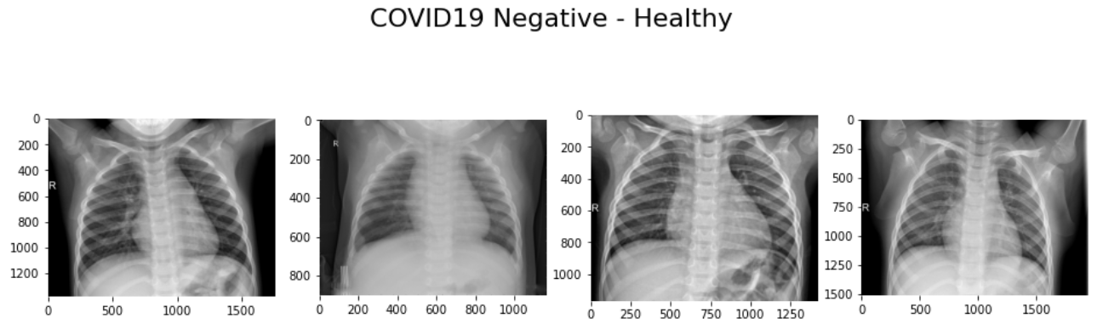
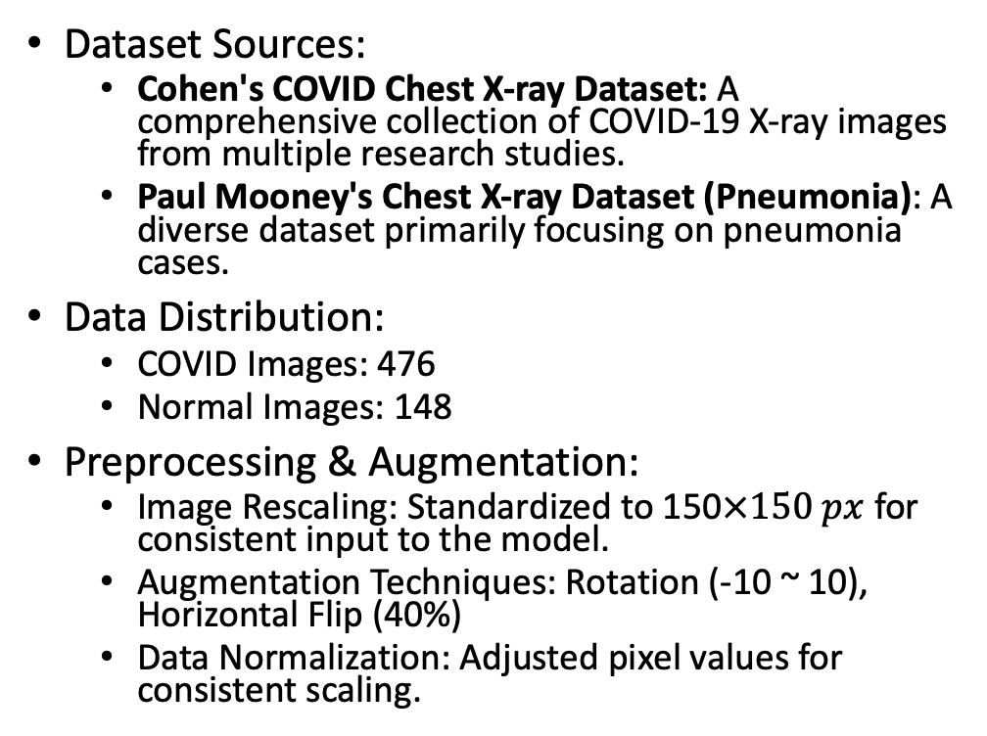
Overview of the Dataset
Dataset Sources:
Cohen's COVID Chest X-ray Dataset: A comprehensive collection of COVID-19 X-ray images from multiple research studies.
Paul Mooney's Chest X-ray Dataset (Pneumonia): A diverse dataset primarily focusing on pneumonia cases.
Data Distribution:
COVID Images: 476
Normal Images: 148
Preprocessing & Augmentation:
Image Rescaling: Standardized to 150$×150 px$ for consistent input to the model.
Augmentation Techniques: Rotation (-10 ~ 10), Horizontal Flip (40%)
Data Normalization: Adjusted pixel values for consistent scaling.

Slide 11
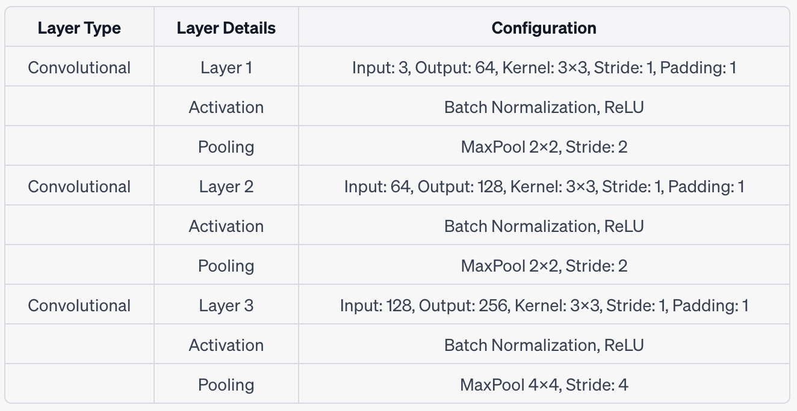
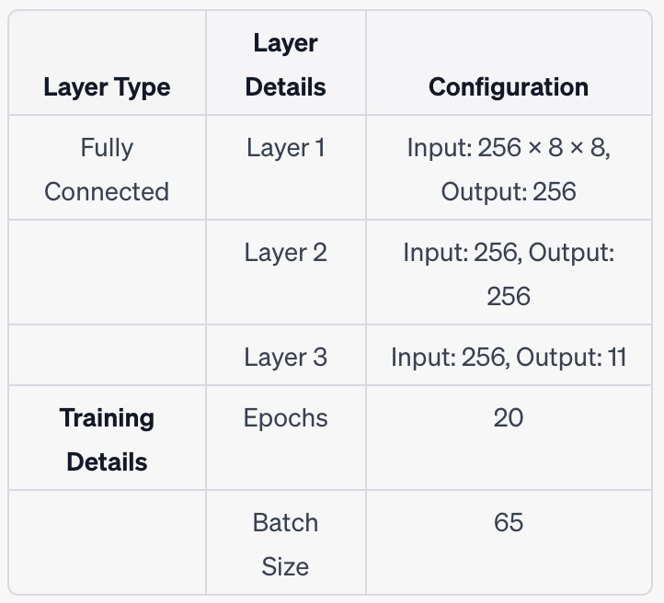
CNN Model Architecture

Slide 12
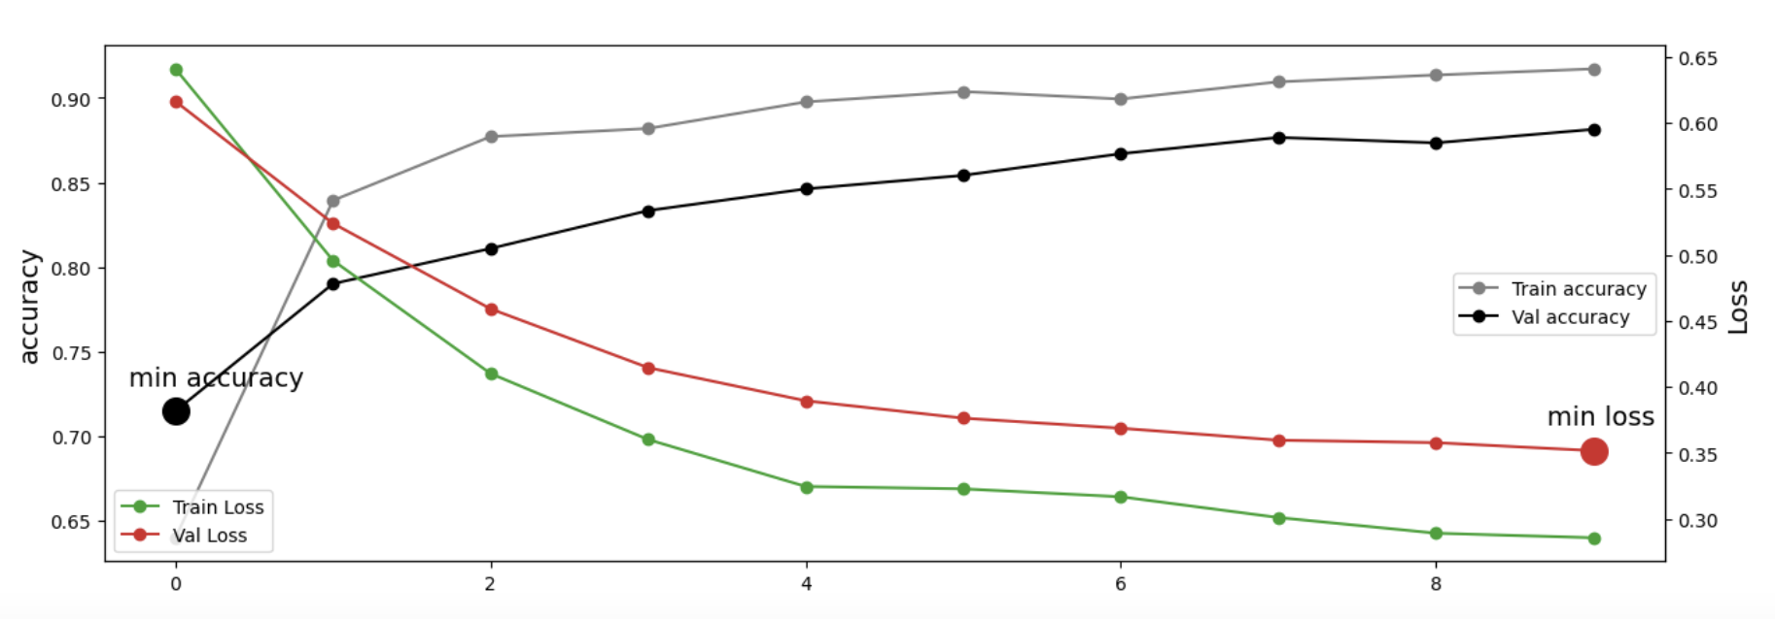
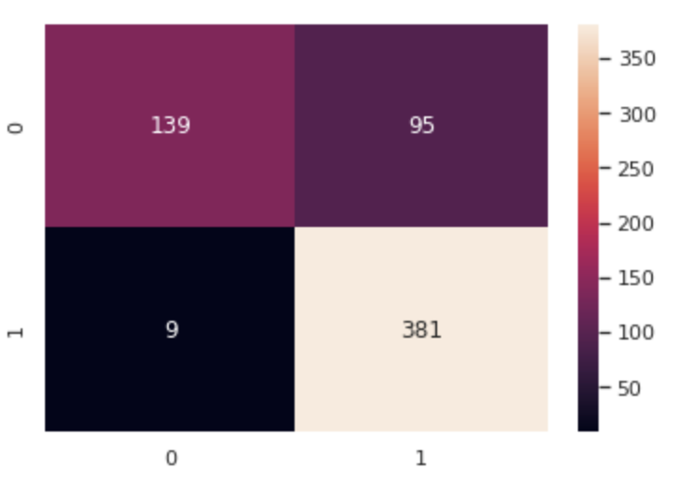
Training Process

Slide 13
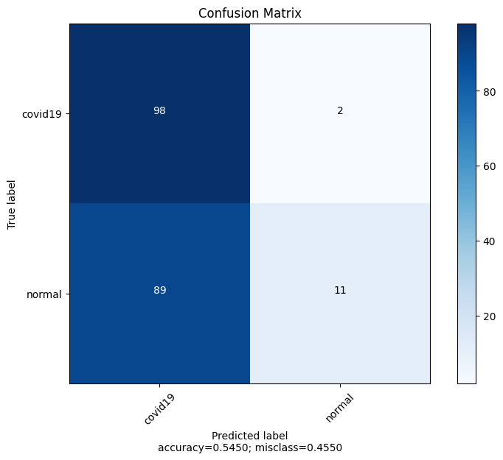
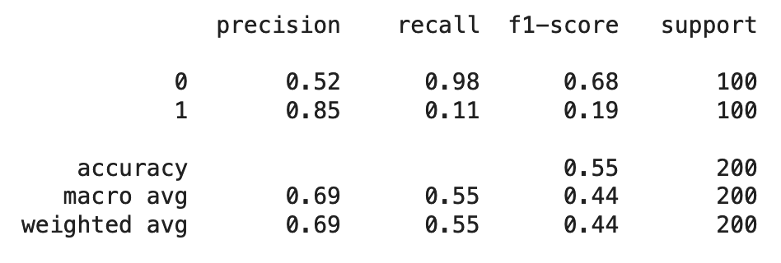
Model Evaluation on New dataset
Dataset: COVID-19 Radiography Database

Slide 14
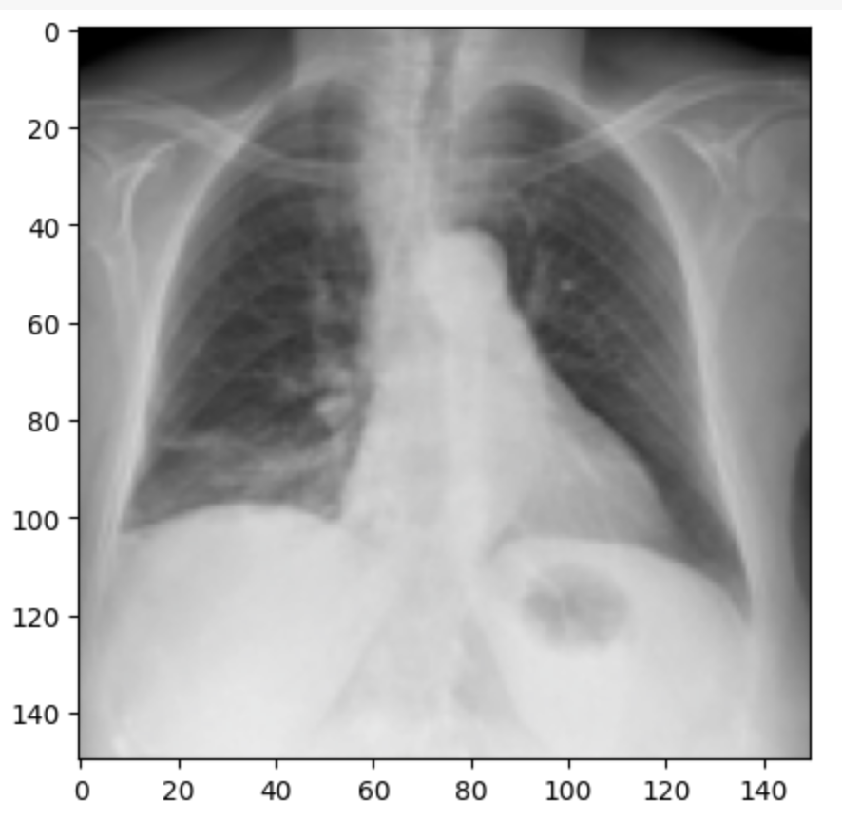
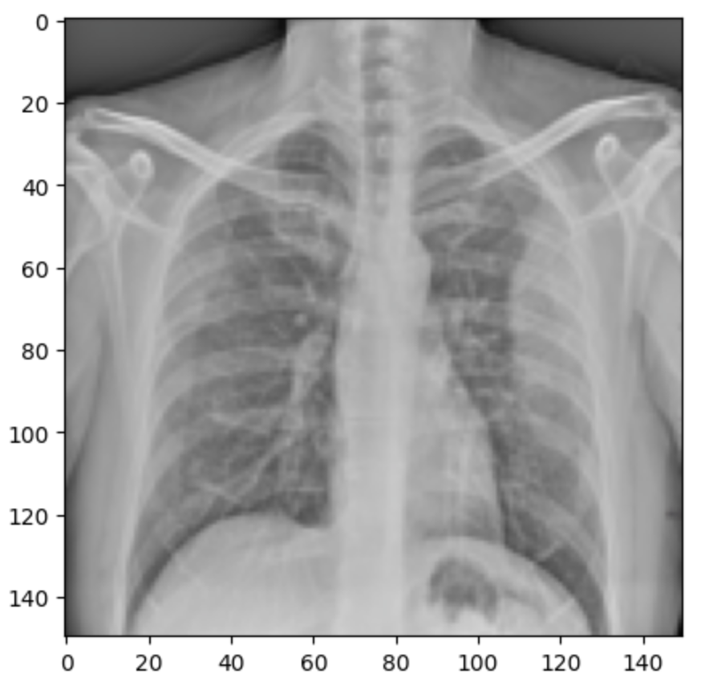
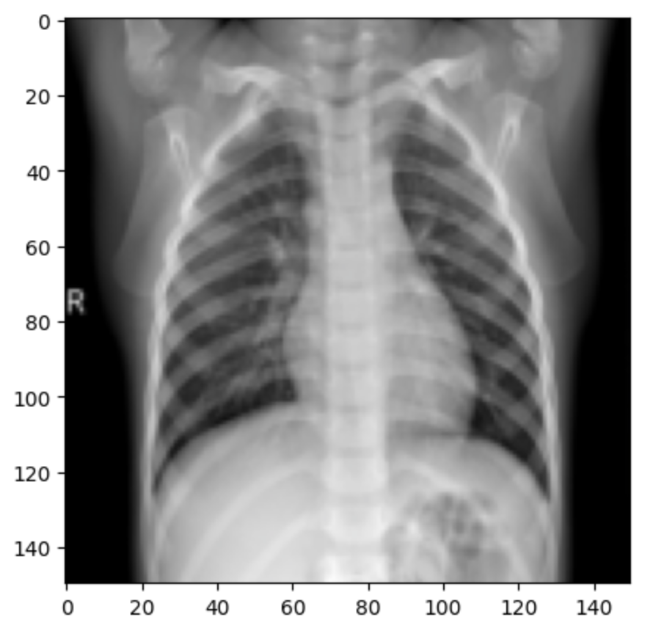
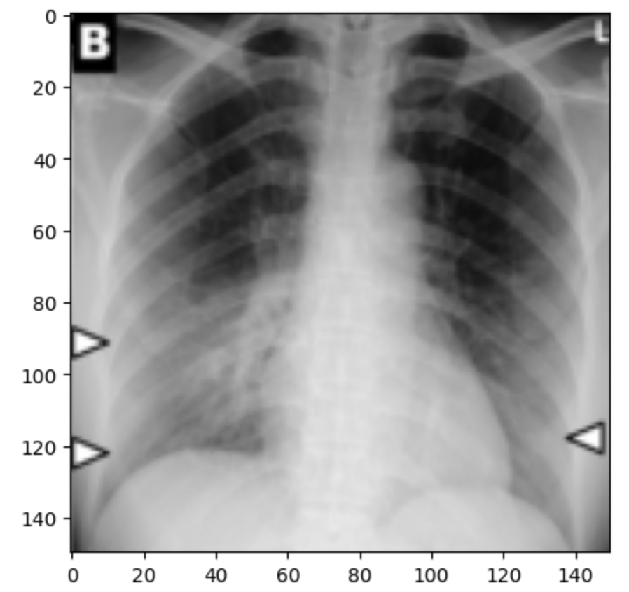
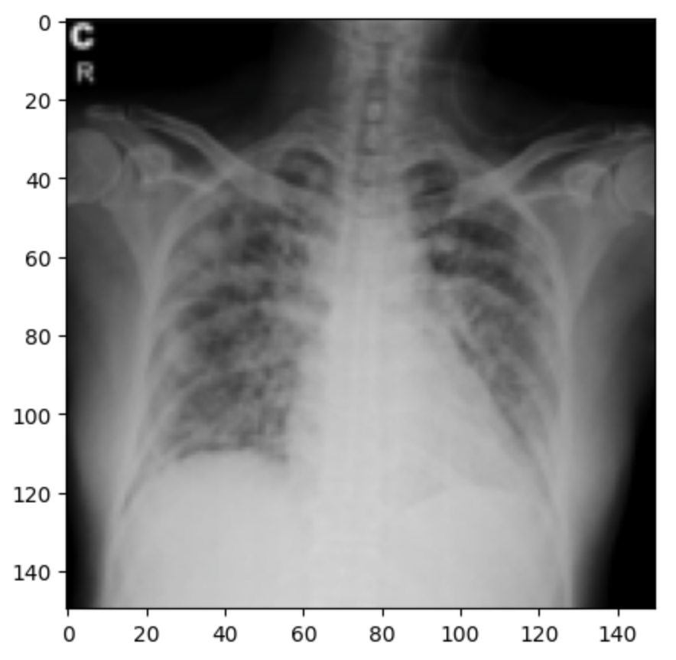
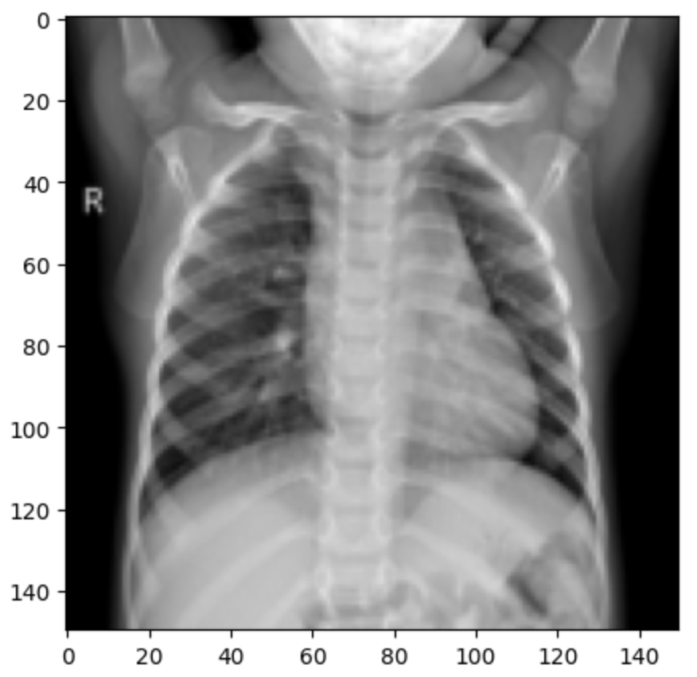
Some Results
Actual: Covid19, Predicted: Covid19
Actual: Covid19, Predicted: Covid19
Actual: Normal, Predicted: Normal
Actual: Covid19, Predicted: Covid19
Actual: Covid19, Predicted: Covid19
Actual: Normal, Predicted: Normal

Slide 15
Challenges & Limitations
Challenges: Understanding model predictions and ensuring trust in model decisions is pivotal in healthcare applications.
Limitations: The model’s ability to generalize to diverse patient populations and various X-ray machine technologies.

Slide 16
Future Works
Developing ensemble models that combine the strengths of various CNN architectures for improved accuracy and stability.

Slide 17
References
Cohen, Joseph Paul. “Ieee8023/Covid-Chestxray-Dataset.” GitHub, 12 Oct. 2023, github.com/ieee8023/covid-chestxray-dataset/tree/master. Accessed 14 Oct. 2023.
“COVID-19 Radiography Database.” Kaggle.com, www.kaggle.com/tawsifurrahman/covid19-radiography-database.
Huang, Gao, et al. “Densely Connected Convolutional Networks.” ArXiv.org, 2016, arxiv.org/abs/1608.06993.
Mooney, Paul. “Chest X-Ray Images (Pneumonia).” Kaggle.com, 2018, www.kaggle.com/paultimothymooney/chest-xray-pneumonia.

Slide 18
Acknowledgment
Mentorship: Thanks to Dr. Xiuquan Wang for his guidance, expertise, and support throughout this project.
Funding: This research was generously supported by the NSF HBCU UP RIA grant. We extend our deepest gratitude for their investment and belief in our work.

Slide 19
Questions?

